Slide 1


Book Ordering System An Innovative Online Bookstore Solution
Submitted To
Project Supervisor
Mr. Ali Azgar
Assistant Professor
Department of Computer Science & Engineering
Presented By
Md. Imran Hossen (21222203001)
Rohan Rashid (21222203050)
Rajesh Chandra Barman (21222203002)
Istiak Ahmed Arnob (21222203028)
Bikash Chandra Ray (21222203045)

Slide 2
Outline
Introduction
Problem statement
Objective
Motivation
Literature review
Features
Fragmentation
Fragmented Database
Diagrams
System Design
Future works
References

Slide 3
Introduction
What is a Distributed Database System?
Why do we need a Book Ordering System?

Slide 4
Problem Statement
Our Systems Face Challenges Such As:
Performance Bottlenecks
Single Point Of Failure
Low Scalability
Using A Distributed DBMS With Fragmentation And Replication Solves These Problems By Improving Data Distribution And Access Efficiency.

Slide 5
Objective
Develop a distributed book ordering system using category-wise data partitioning.
Goals:
- Improve system performance
- Enhance fault tolerance
- Ensure efficient access to distributed data

Slide 6
Motivation
Book Categories Like Knowledge, Academic, Magic, And Adventure Have Varying Access Patterns.
Distributing Categories Across Nodes:
Balances Server Load
Enhances Modularity
Improves Response Time
Enables Localized Transactions

Slide 7
Technology Stack
Frontend:
HTML5, CSS3, JavaScript, Bootstrap.
Backend:
PHP
Database:
MySQL.
Hosting:
Localhost or Cloud-Based Servers.

Slide 8
Literature review
Ezéchiel Et Al. [1] (2019) Reviewed Distributed Database Systems (DDBS) Focusing On Three Strategies: Data Fragmentation, Allocation, And Replication. Key Challenges Include Query Optimization For Fragmented Data, Np-hard Allocation Problems, And Synchronization In Replicated Systems. The Paper Proposes Solutions For Efficient Synchronization, Particularly In Decentralized Peer-to-peer (P2P) Setups, Highlighting The Need For Scalability And Autonomy
Santiago Et Al. [2] (2021) Explored The Integration Of Distributed Database Systems (DDBS) In Data Security, Emphasizing Scalable And Expandable Access Control Models. The Paper Discusses The Challenges Of Implementing Access Control, Such As The Complexity Of DDBS, Data Integrity, And The Need For Skilled Management. It Also Examines Real-world Applications In Sectors Like IT And Social Media, Stressing The Importance Of Robust Security Measures And Future Research In Enhancing Data Protection.

Slide 9
Features
- Distributed book storage based on category: knowledge, academic, magic, adventure
- Global search with local data management
- Category-specific transactions and fault isolation

Slide 10
Fragmentation
Horizontal fragmentation strategy by User Branch:
- Dhaka Branch
- Rajshahi Branch
- Chittagong Branch
BOOK ORDERING SYSTEM
Dhaka
Chittagong
Rajshahi

Slide 11
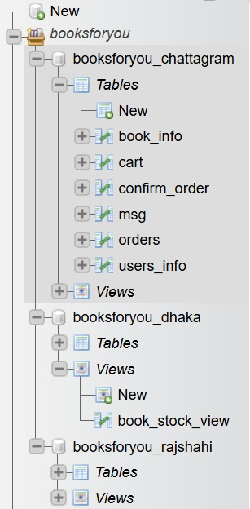
Fragmented Database
Database View
Nodewise Fragmentation
BOOK ORDERING SYSTEM
Node 1 → Dhaka Branch
Node 2 → Chittagong Branch
Node 3 → Rajshahi Branch

Slide 12
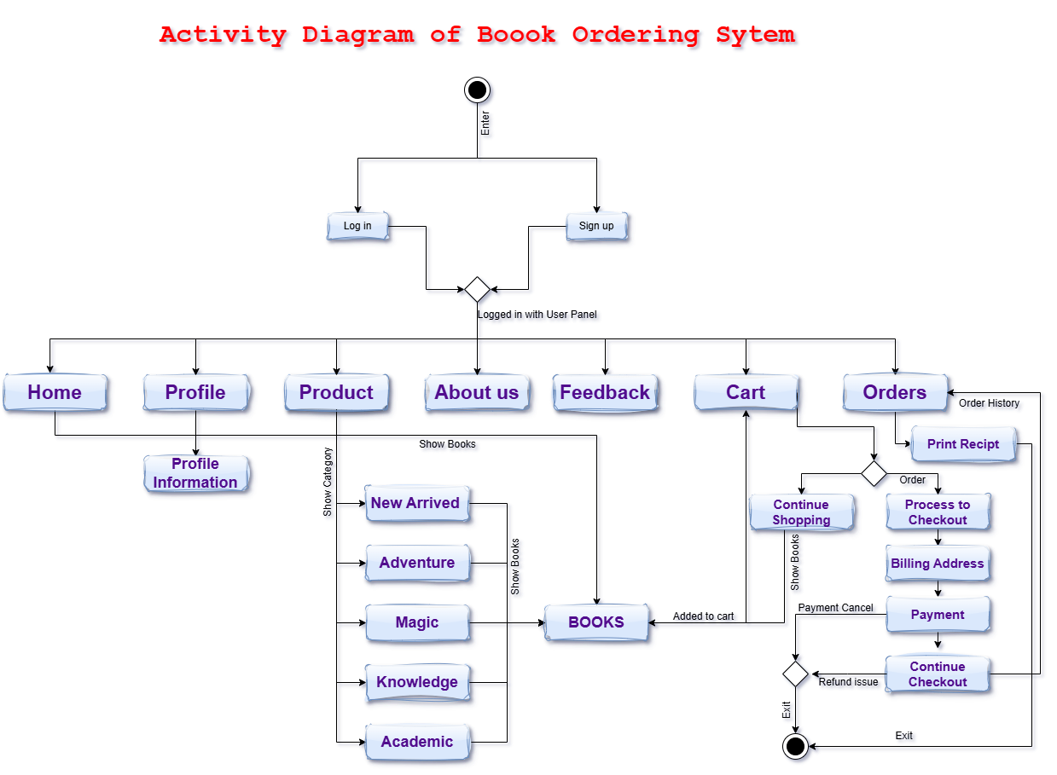
Workflow diagram Flow of Data: Showing a activity diagram of how data flows between modules.

Slide 13
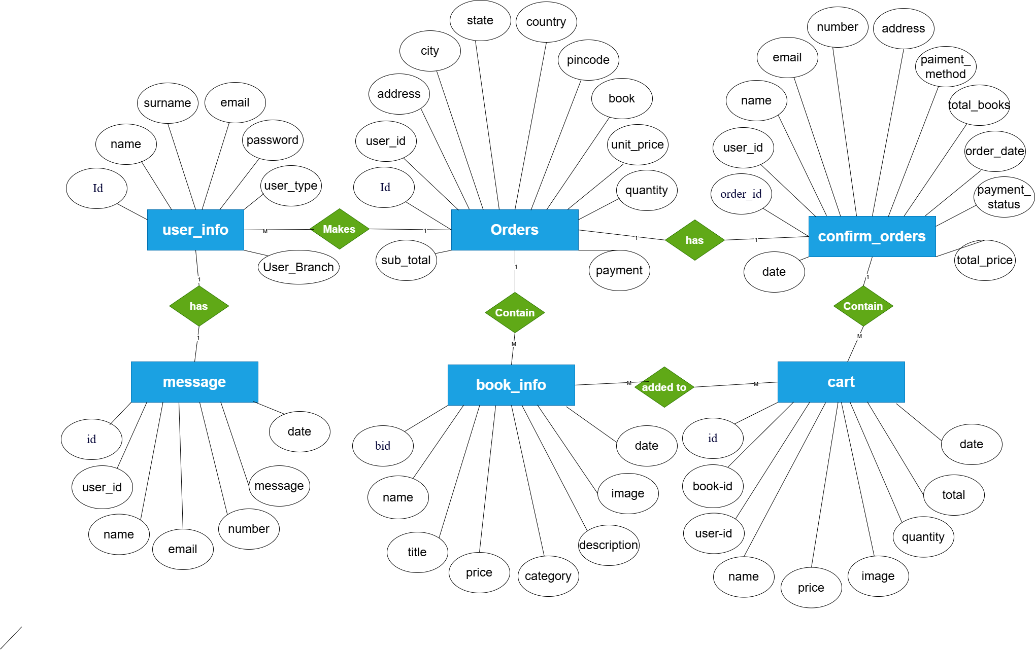
ER Diagram: Highlight relationships between key entities like Users, Books, and Orders

Slide 14
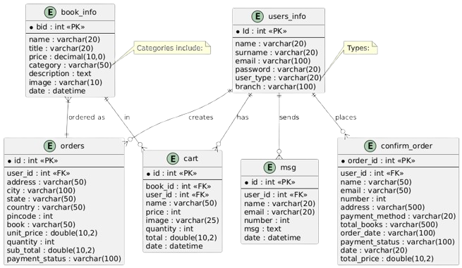
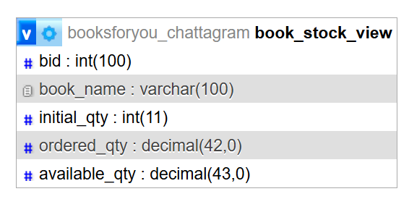
Database (Schema Diagram) Database Tables: Highlight table structure for Users, Books, and Orders.

Slide 15
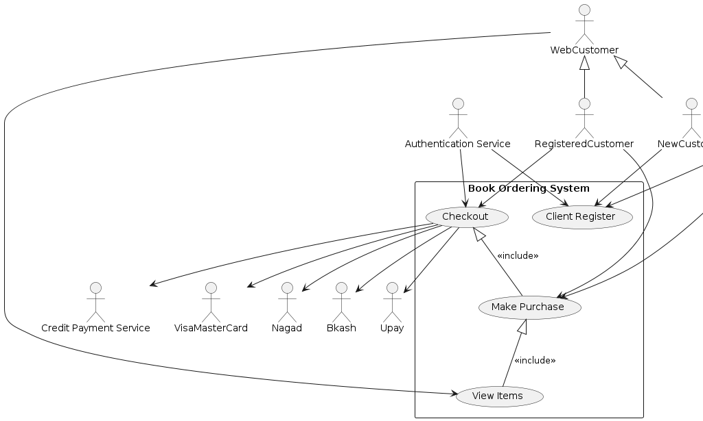
Use Case Diagram: Show interaction between users, administrators, and the system.

Slide 16

System Architecture
User Module: Homepage.
System Home Page

Slide 17
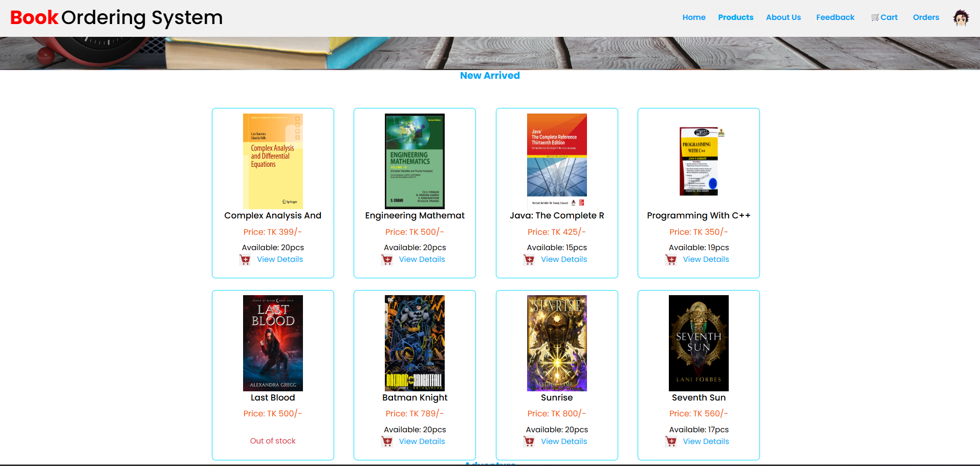
System Architecture
User Module: Homepage.
System Home Page

Slide 18
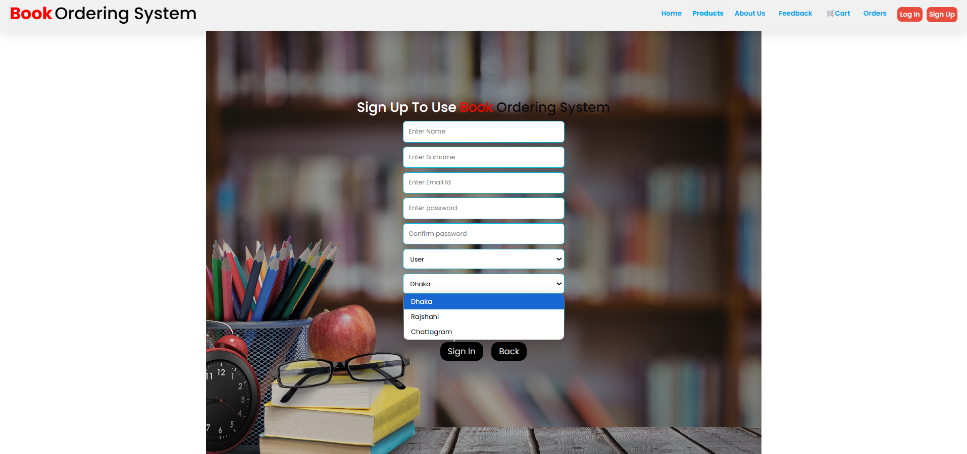
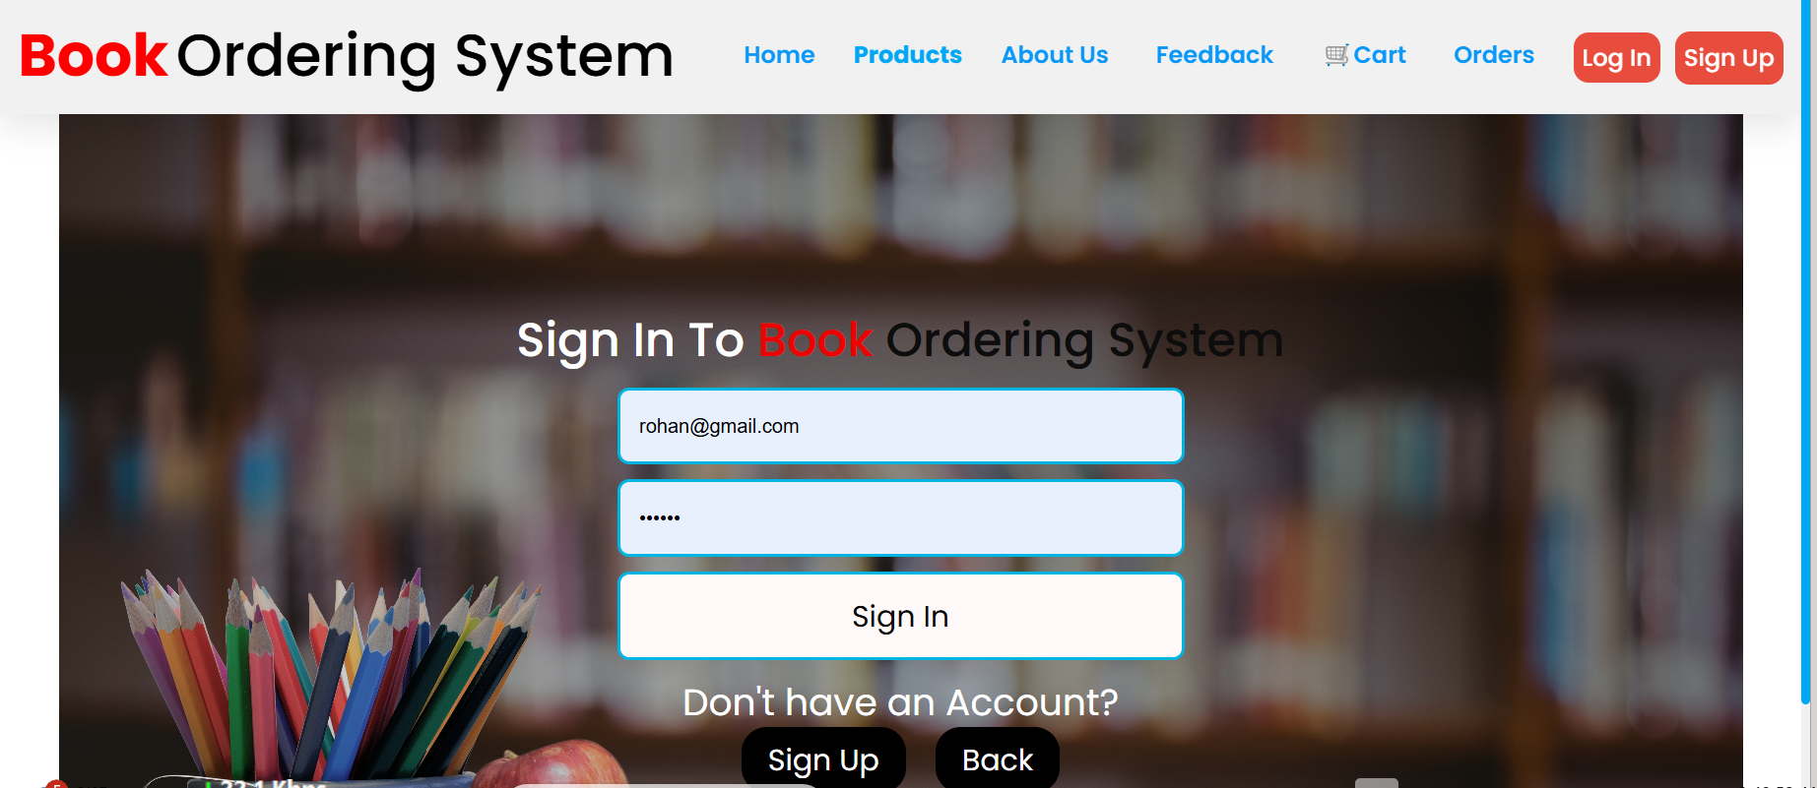
System Architecture
User Module: Registration, login, and profile management.
Registration & Log in Page

Slide 19
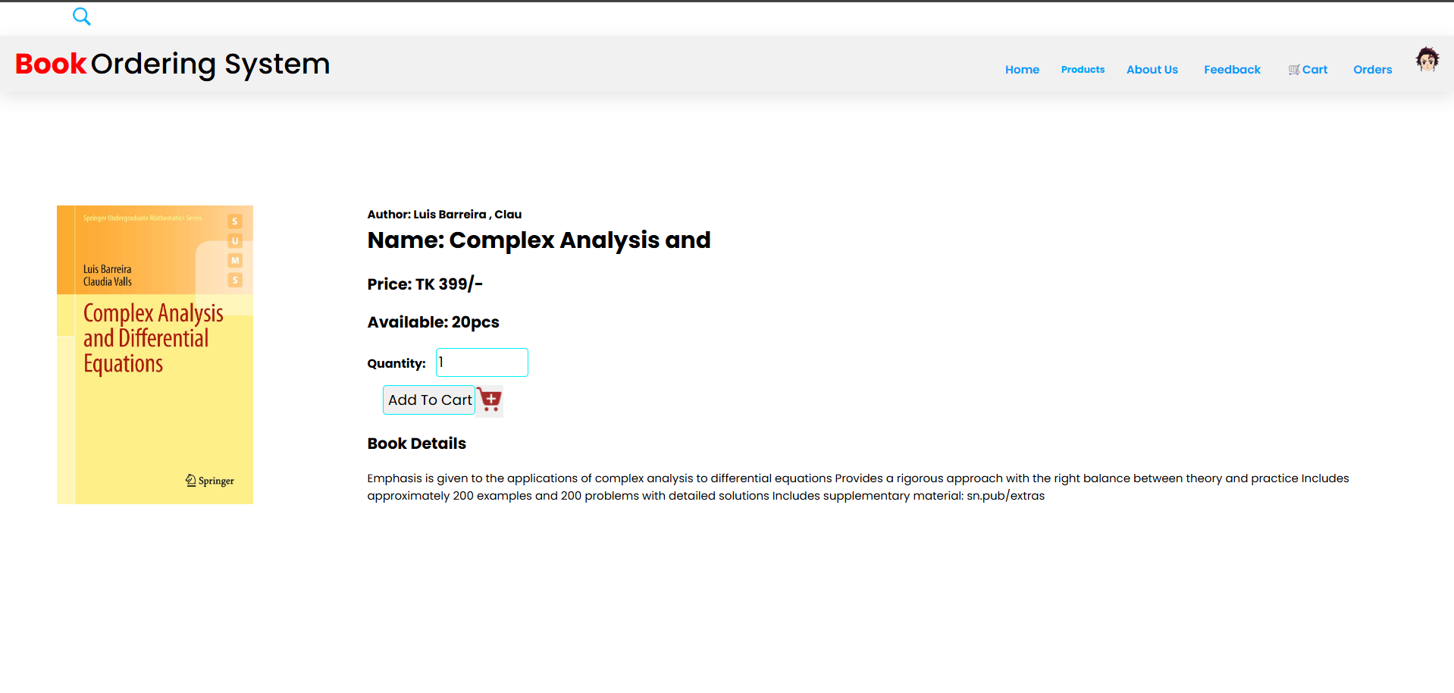
System Architecture
Book Module: Search, browse, and add to cart.
Searching a Book named ‘Java’ and added to the cart for Order

Slide 20
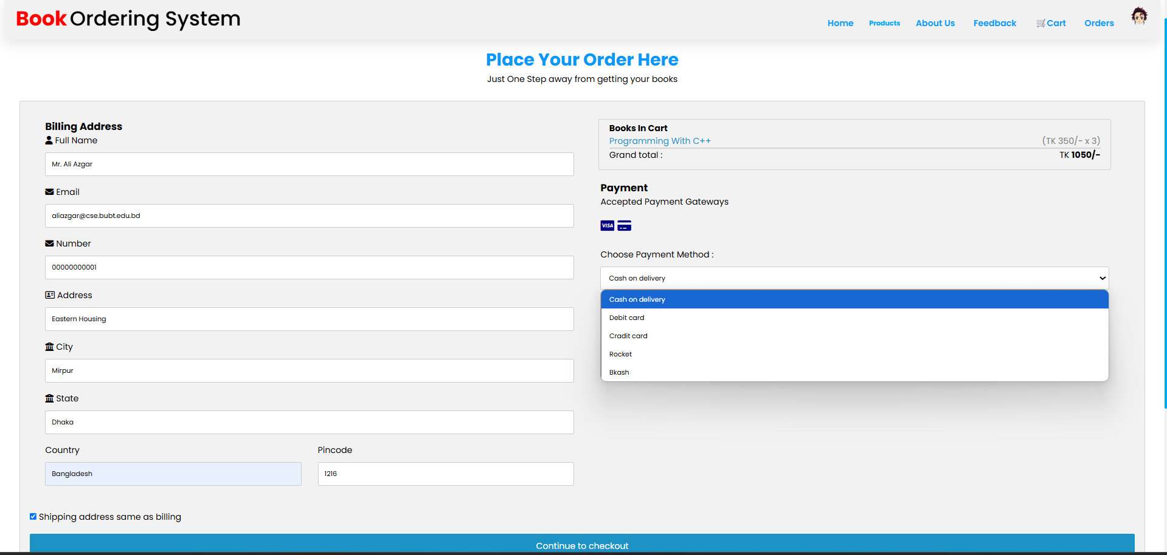
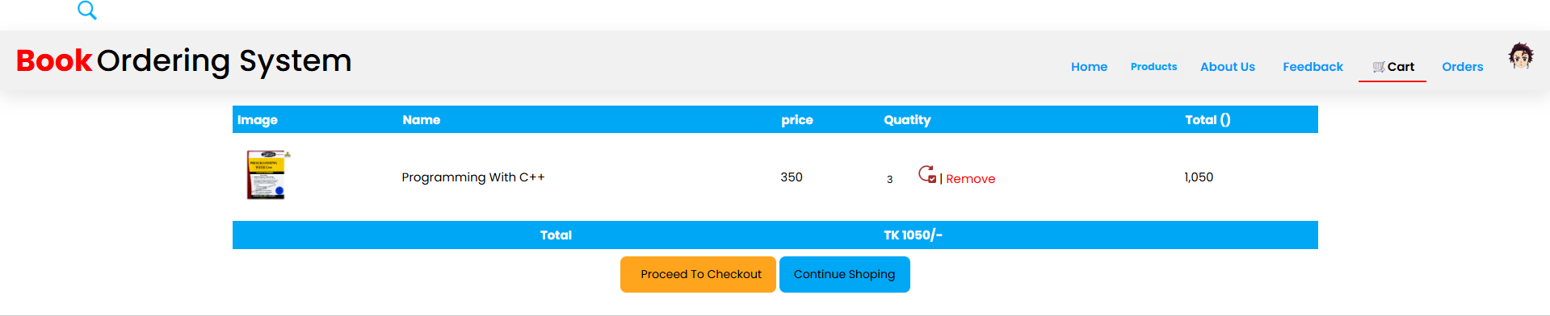
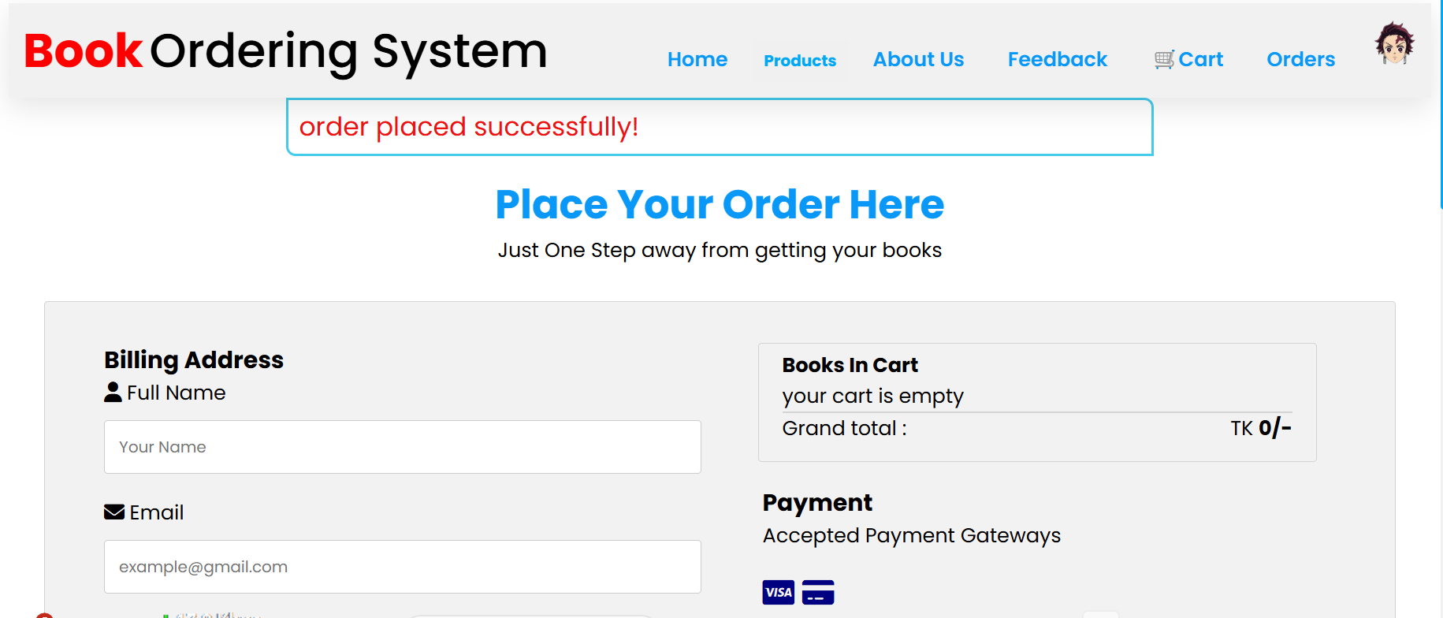
System Architecture
Order Module: Order processing and tracking.
Order Processing with Delivery Address

Slide 21
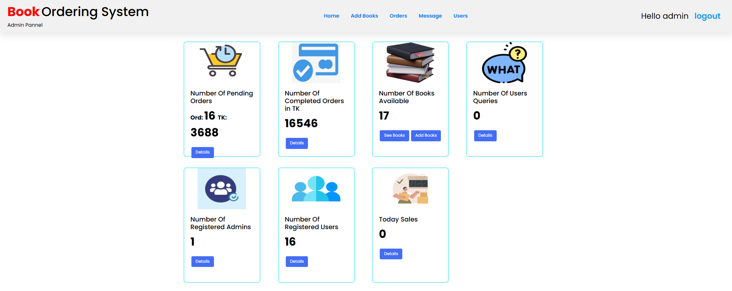
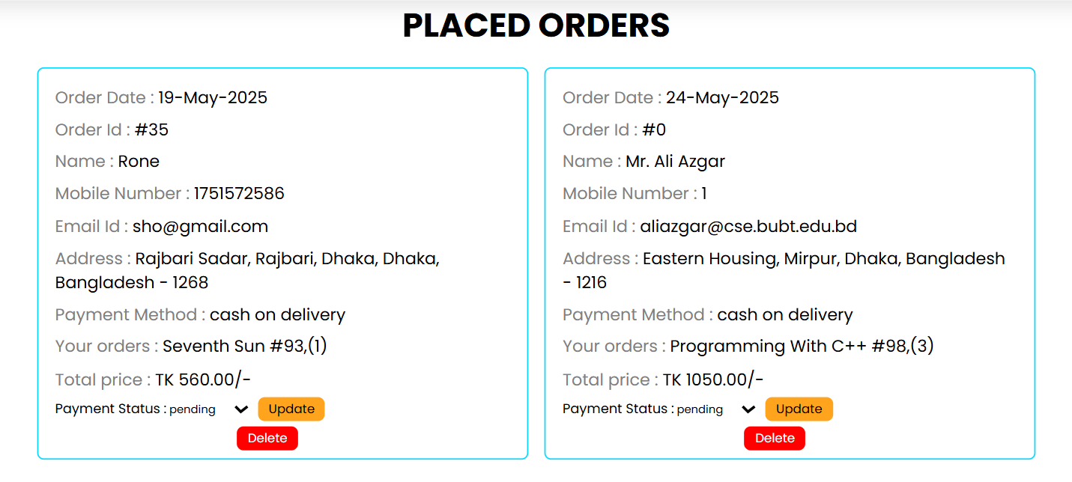
System Architecture
Admin Module: Inventory management and order supervision.

Slide 22
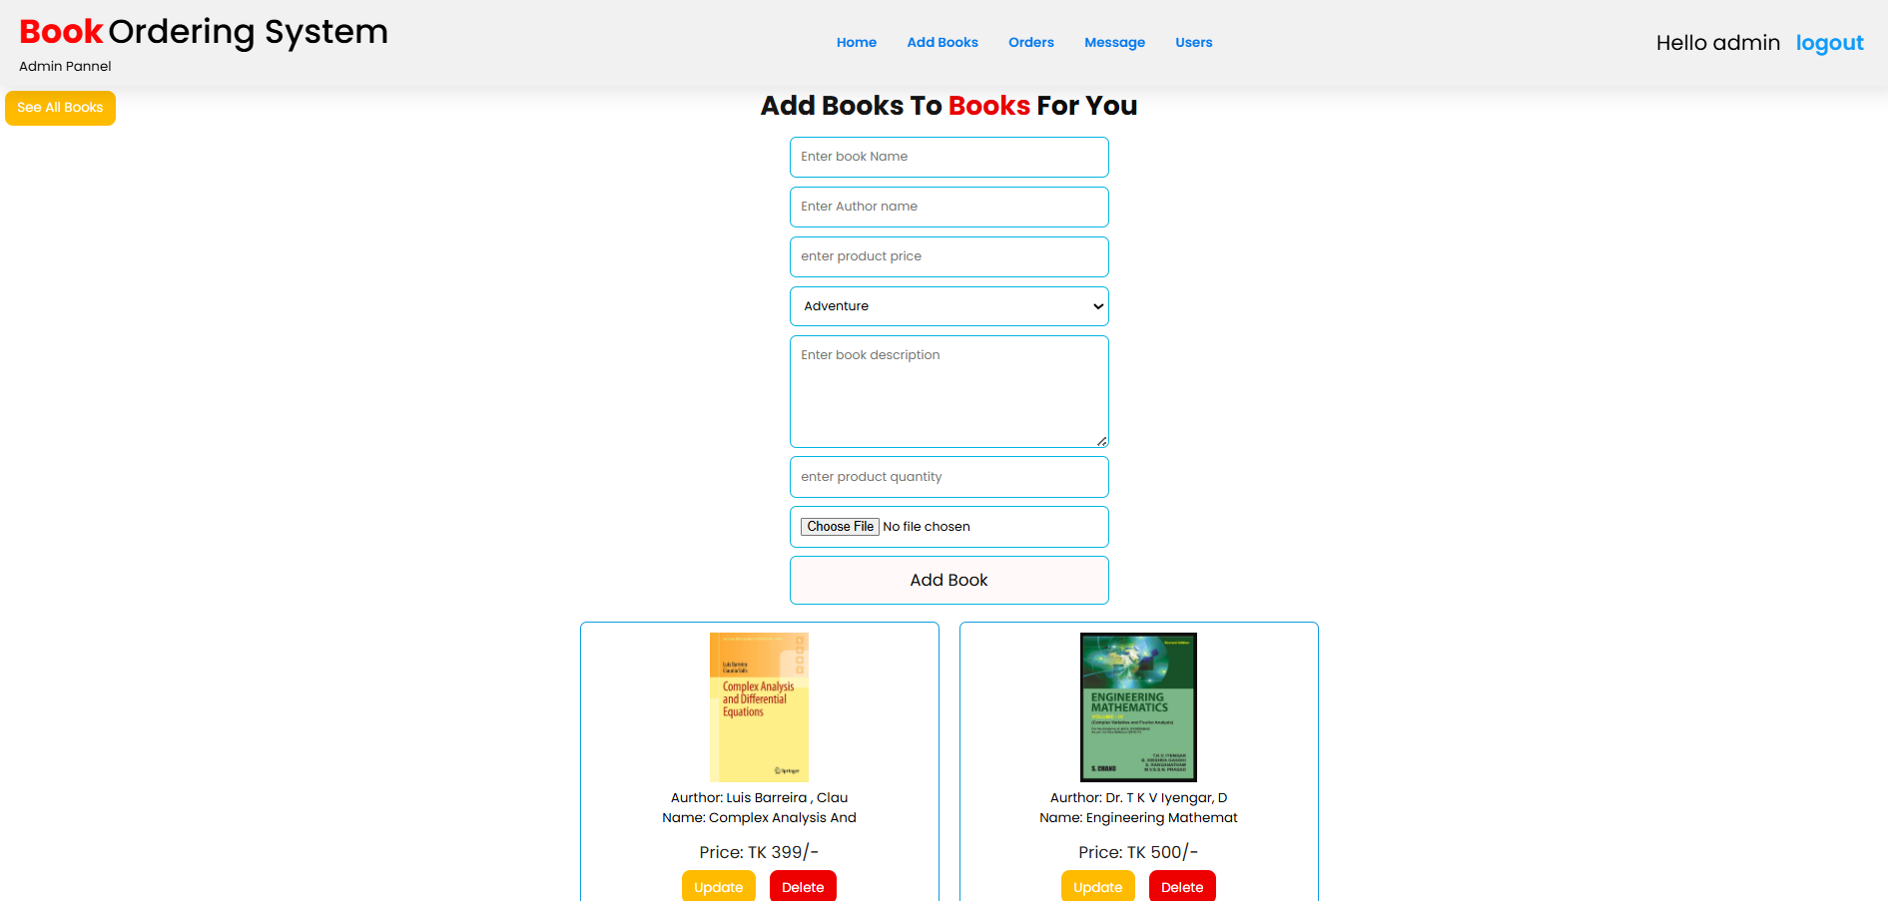
System Architecture
Admin Module: Adding books.

Slide 23
🔮 Future Work
AI-Based Book Recommendations Personalized suggestions based on user activity.
Real-Time Inventory Updates Instant stock synchronization across all nodes.
Mobile App Development Cross-platform apps for Android and iOS users.
Chatbot for Customer Support 24/7 automated help for quick issue resolution.
Integration with E-Payment Gateways Smooth and secure online transactions.
Add More Branches Expand system architecture by adding more server nodes to increase availability and scalability.

Slide 24
References
Guclu, M., Bakir, C., & Hakkoymaz, V. (2020). A New Scalable And Expandable Access Control Model For Distributed Database Systems In Data Security. Scientific Programming, 2020.
Dheeba, J., Singh, N. A., & Selvi, S. T. (2014). Computer-aided Detection Of Breast Cancer On Mammograms: A Swarm Intelligence Optimized Wavelet Neural Network Approach. Journal Of Biomedical Informatics, 49, 45–52.
Shen, R., Yan, K., Tian, K., Jiang, C., & Zhou, K. (2019). Breast Mass Detection From The Digitized X-ray Mammograms Based On The Combination Of Deep Active Learning And Self-paced Learning. Future Generation Computer Systems, 101, 668–679.
Qi, X., Zhang, L., Chen, Y., Pi, Y., Chen, Y., Lv, Q., & Yi, Z. (2019). Automated Diagnosis Of Breast Ultrasonography Images Using Deep Neural Networks. Medical Image Analysis, 52, 185–198.
Wilkinson, I., & Graves, M. (). Magnetic Resonance Imaging: In: Adam A, Dixon Ak, Gillard Jh, Schaeferprokop Cm, Eds. Grainger & Allison’s Diagnostic Radiology: A Textbook Of Medical Imaging.
Hossam, A., Harb, H. M., & Abd El Kader, H. M. (2018). Automatic Image Segmentation Method For Breast Cancer Analysis Using Thermography. Journal Of Engineering Sciences, 46, 12–32.

Slide 25
Thank You Do You Have Any Question???

